Slide 1
STOCK PRICES PREDICTION USING REINFORCEMENT LEARNING ALGORITHMS
SUBASH SHANKAR

Slide 2
CONTENTS
Introduction and Problem
Dataset
A Brief Introduction on Actor-Critic method
Implementation (Actor-Critic Method for Stock Prediction)
Results and Metric of Evaluation
Conclusion and Future Work

Slide 3
Introduction and Problem
Rapid and uneven fluctuations
Need better tools to make accurate analysis before investment
Past researchs in Recurrent Neural Networks and LSTM(Long Term Short Memory)
Actor-Critic Method to predict best action; Buy, Sell or Hold. To make higher profit.

Slide 4
Github Repo
https://github.com/subash96/Stock-Prices-prediction-using-Reinforcement-Learning.git

Slide 5
Why Reinforcement Learning Approach??
Why Reinforcement Learning compared to more Supervised learning Approaches?
For successful predictions in supervised learning, we need to make larger predictions and we have no policy.

Slide 6
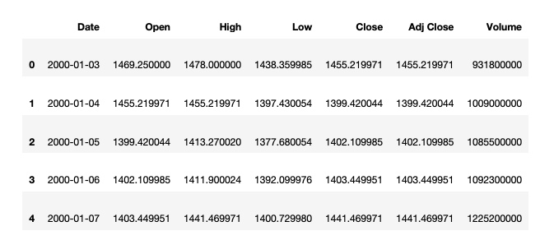
Dataset and its Features

Slide 7
Dataset and its Features - Contd
Date - Particular day these in consideration
Open - Rate at which market opens
High - Highest price in Market on that particular day
Low - Lowest price in Market on that particular day
Close - Price at which market closed on that particular day
Adj Close - Adjusted closing price for both split and dividends
Volume - Volume of shares available

Slide 8
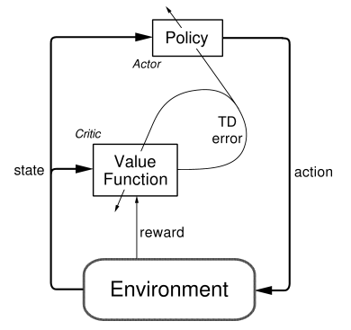
A Brief Introduction on Actor-Critic Method
Actor - Policy
Critic - Value function

Slide 9
Implementation(Actor-Critic Method for Stock Prediction)
Agent = Trader
State Space =[p,t,w]
Action space = 3 (Buy, sell or Hold)
Actor returns probabilities for each action. An action based on maximum probability through softmax activation
Learning occurs
Predict Target Q_values and fit it in the critic network
Calculate action gradient and use this to train the actor network

Slide 10

Training Video

Slide 11
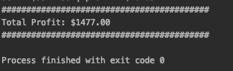
Results and Metric of Evaluation
The metric of evaluation is Profit.
I was able to see a profit of $1477.00

Slide 12
Conclusion and Furure Work
A small profit was achieved
Better solution among others that are out there
Multiple Agents like Agent 1 trained over Price, Agent 2 trained over sentiment and other market factors etc...

Slide 13
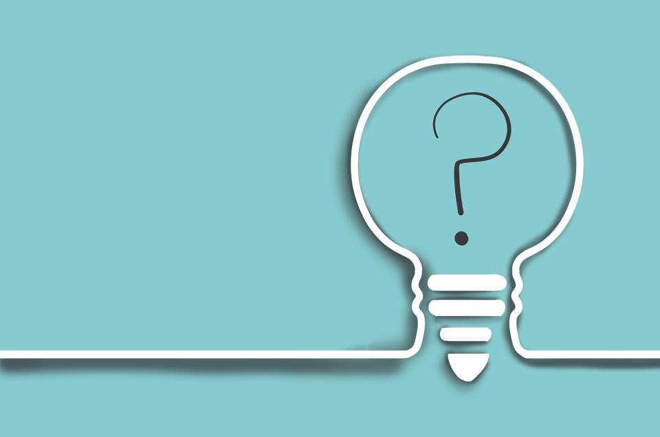
Questions?

